Slide 1
Where is Sub-Saharan Africa in its Mortality Trajectory? Understanding the Past and Prospects for the Future
Ayaga A. Bawah, PhD
Regional Institute for Population Studies (RIPS)
University of Ghana, Accra, Ghana
Keynote Address
Africa Mortality Symposium
29th November 2022

Slide 2
Outline
Global Context
Mortality Trends in Sub-Saharan Africa
Infant and Child Mortality
Adult Mortality
Why Mortality Remains High in SSA
Assessing Progress and Prospects for the Future

Slide 3
Global Context
Globally there has been remarkable decline in mortality
General mortality declined in excess of 67 percent
Declines witnessed in all subregions of the world
Due improvements in public health and socioeconomic conditions across the world
But these gains have been uneven across the world

Slide 4
Variations in Levels and Trends in Under-five Mortality, by SDG Region, 1990-2019

Slide 5
Childhood Mortality Witnessed Greatest Decline
Gains have been particularly strong among children
Since 1990 child mortality has declined by about 60 percent to about 58 deaths per 1000 in 2019
Most public health interventions have focused more on children and pregnant women

Slide 6
Despite Gains, Mortality Rates Remain Unacceptably High
Despite reductions in global burden of child deaths, rates remain high
For instance, 5.2 million deaths occurred among children under 5 years of age worldwide in 2019

Slide 7
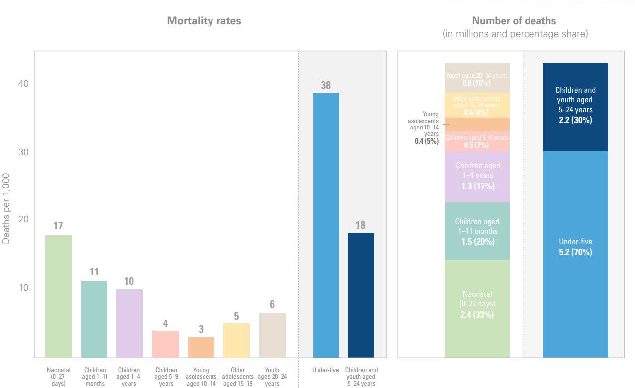
Global Mortality Rates and Number of Deaths by Age, 2019 (UN Inter-agency Group for Child Mortality Estimation)
Notes:
Check spacing of bars

Slide 8
Most Child Deaths Concentrated in SSA
Of the 5.2 million deaths to children under 5 years of age 53 percent occurred in SSA
SSA also bears 44 percent of all child deaths 5-24 years of age

Slide 9
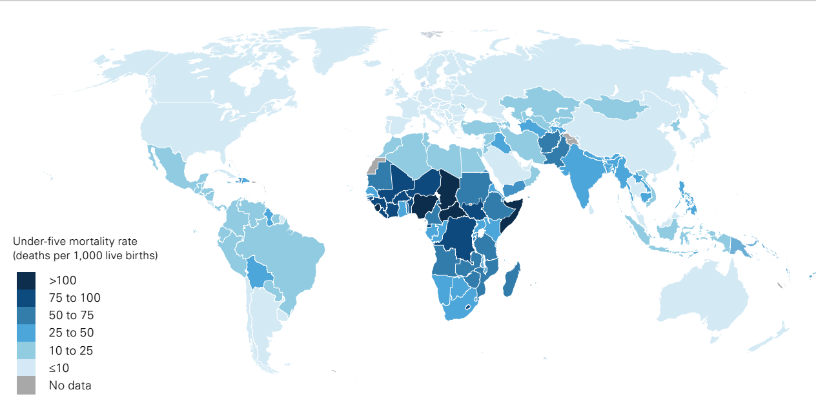
Under-five Mortality Rate (Deaths per 1,000 Live Births) by Country, 2019 (UN Inter-agency Group for Child Mortality Estimation)

Slide 10
Digging Deeper into SSA
SSA has the highest risk of mortality both among children and adults
But substantial progress has been made to reduce mortality in the region
Data from the UN show that under 5 mortality in SSA declined from 180 in 1990 to 76 in 2019
Variations exist regionally

Slide 11
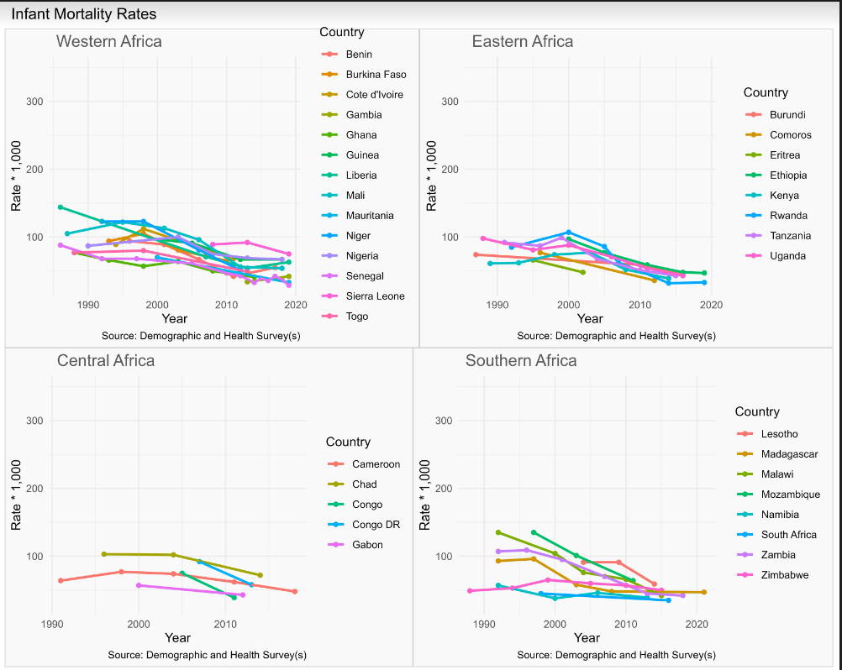
Trends in Infant Mortality Rates in SSA

Slide 12
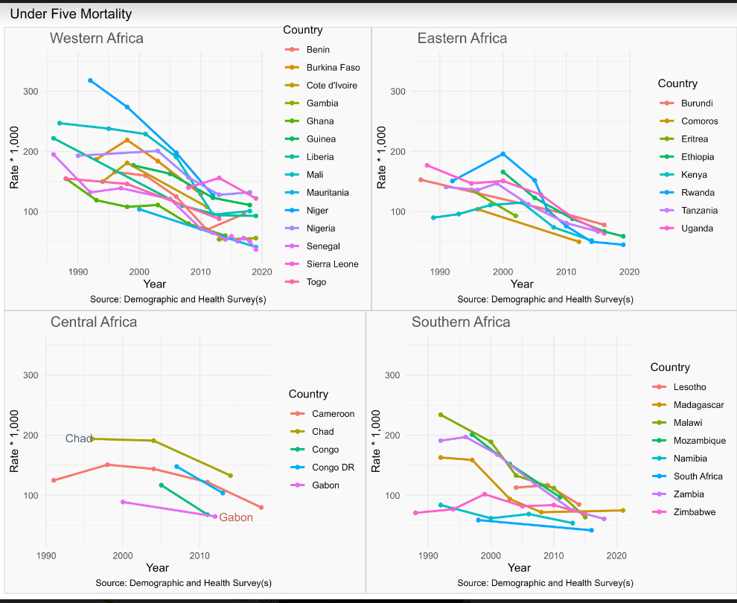
Trends in Under Five Mortality Rates in SSA

Slide 13
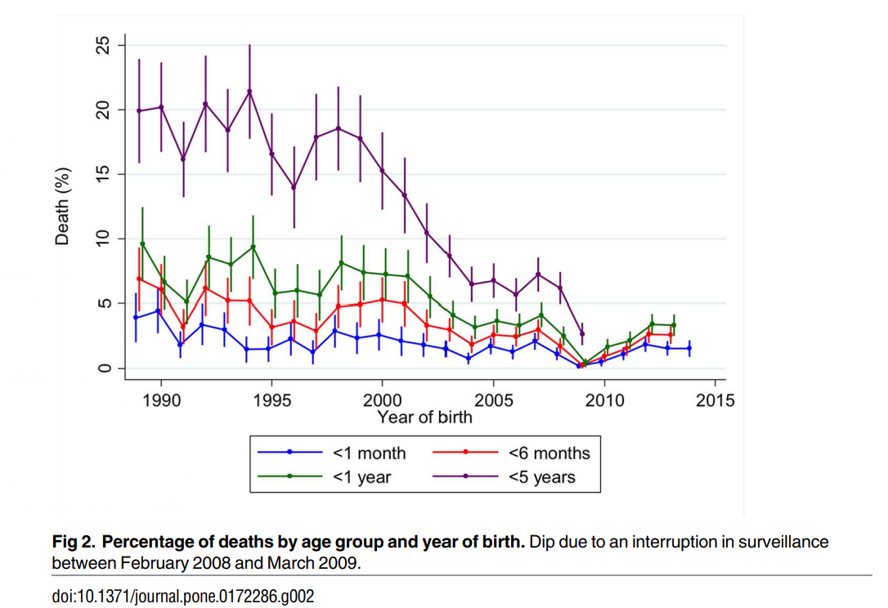
Trends in Childhood Mortality based on Gambia Health and Demographic Surveillance Data

Slide 14
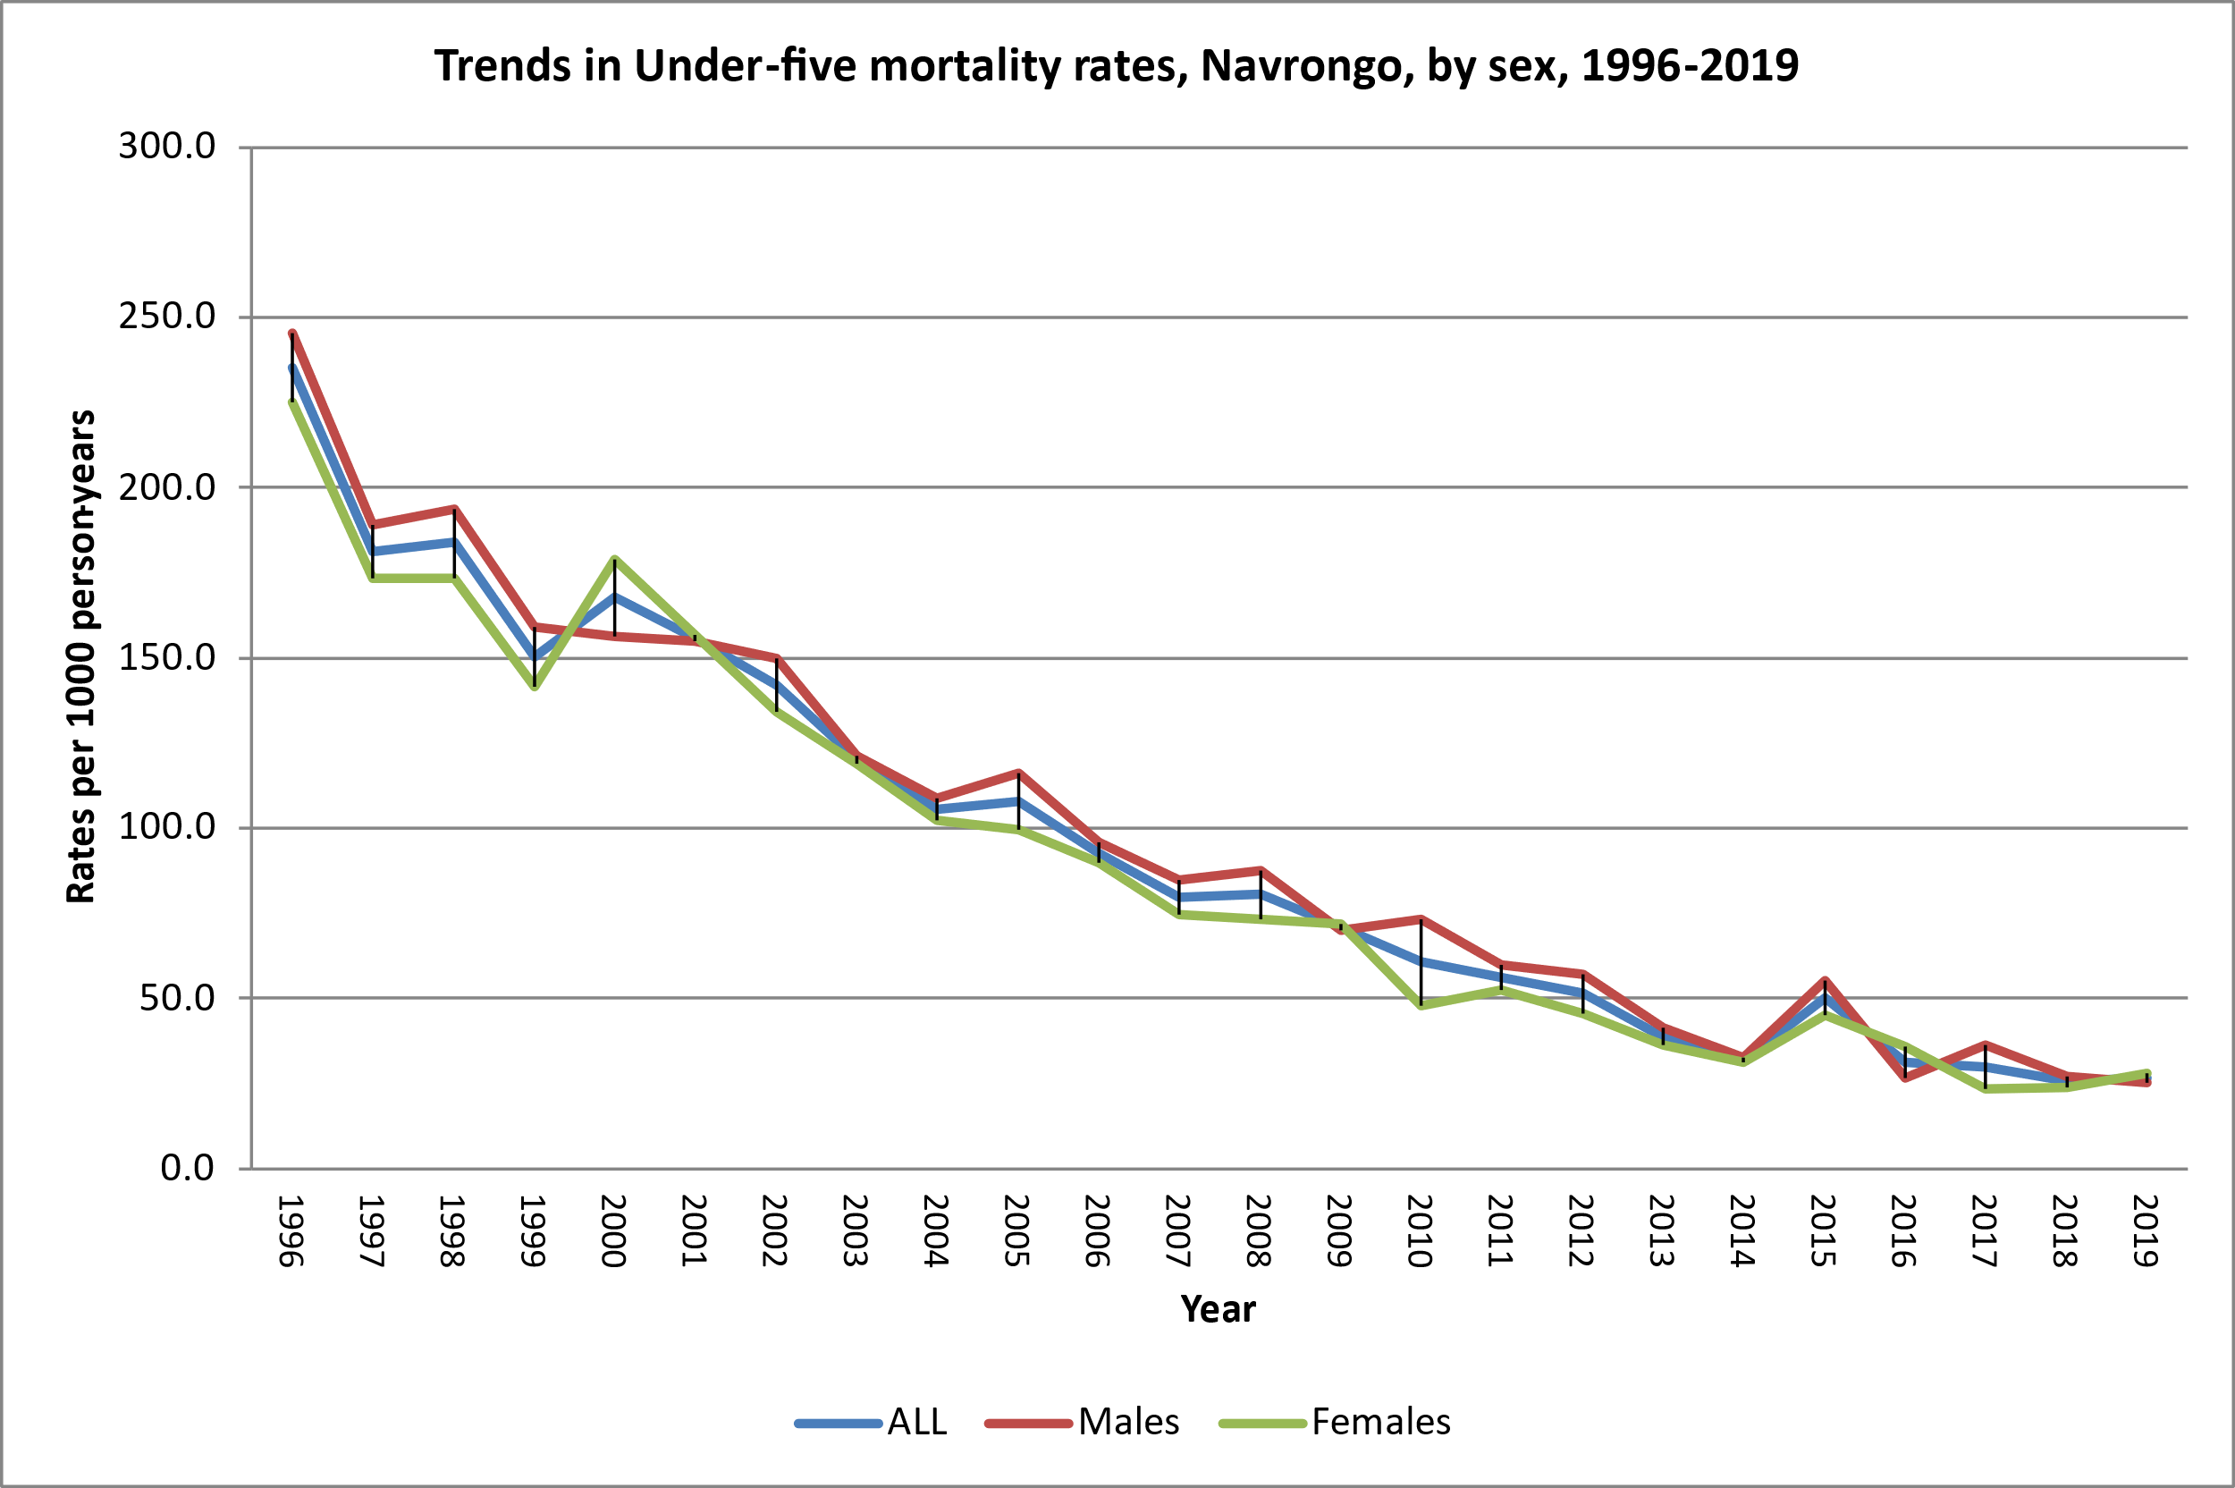
Trends in Childhood Mortality from the Navrongo HDSS, Ghana

Slide 15
Mark Hereward, UNICEF’s Associate Director on Data and Analytics
“We are still losing too many young lives from largely preventable causes, often because of weak and underfunded health systems which have faced enormous pressure over the pandemic. And the burden of these deaths is not carried equally around the world. Children in sub-Saharan Africa and Southern Asia continue to face the highest risk of death in the world, and to bear the brunt of this child mortality burden,…
If we are going to achieve the child mortality SDGs in all countries, we must redouble efforts to ensure access to effective and high-quality care along with the continued expansion of coverage of life-saving interventions.”
20 December, 2021

Slide 16
Maternal and Adult Mortality
Data on adult mortality has remained a challenge in the region
Notwithstanding, the available data shows that progress has been made in reducing adult mortality
WHO estimates that between 2000 and 2017 the maternal mortality ratio dropped by about 38.4% worldwide
In SSA the MMR is estimated to have declined from 878 per 100,000 live births in 2000 to 542 per 100,000 live births in 2019

Slide 17
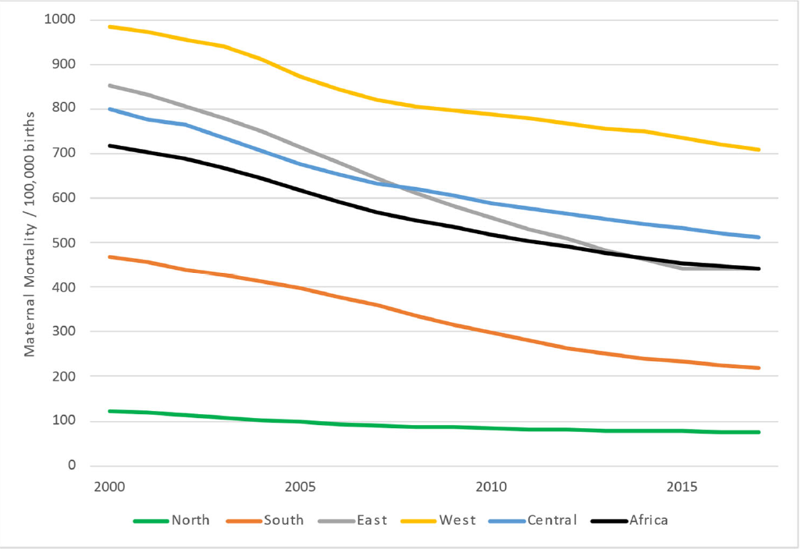
Trends in Maternal Mortality Rates in Africa (2000–2017)
Source: Onambele et al . 2022. Int. J. Environ. Res. Public Health

Slide 18
Adult Mortality: Probability of Dying between 15 and 60 Years of Age

Slide 19
Trends in Life Expectancy in SSA

Slide 20
Why Mortality Remains High in SSA
Vaccine-preventable childhood deaths continue to be high
High Maternal mortality
Infectious diseases remain a major threat to many people in the region
Large segments of the population remain poor and continue to die of either poverty-related diseases or unable to afford healthcare
Noncommunicable diseases are on the rise in many countries of the region

Slide 21
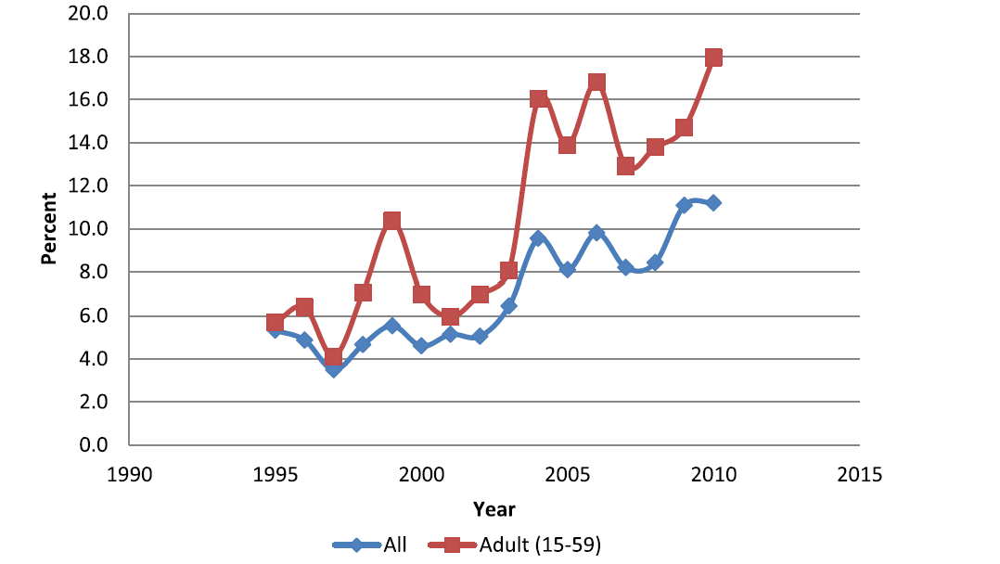
Why Mortality Remains High in SSA
Injury mortality is on the rise and if nothing drastic is done it will become a leading cause of death among adults
Bawah et al. Injury Epidemiology 2014
Health systems are poor and inequitable in many countries

Slide 22
Assessing Progress and Prospects for the Future
The major challenge affecting mortality research in Africa is lack of good quality data.
For purposes of planning there is need to give priority to improving data generation, particularly at the district level.
Data on causes of death must be given priority attention. In this regard countries can think of setting up sentinel sites
Priority must be given to deal with the health system challenges confronting many countries in SSA

Slide 23
Assessing Progress and Prospects for the Future
SDG target 3.1: By 2030, reduce the global maternal mortality ratio to less than 70 per 100000 live births
Projections suggest that SSA is not likely to meet this target
According to the latest estimates by UN IGME 50 countries are off mark towards achieving the SDG under mortality target and 60 for the neonatal mortality target.
Equity in access to health care remains a major challenge and this must be prioritized if must achieve mortality reductions.
If progress must be made, we must double efforts to address problems

Slide 24
Email: aabawah@ug.edu.gh
Thank you for your attention

